Slide 1

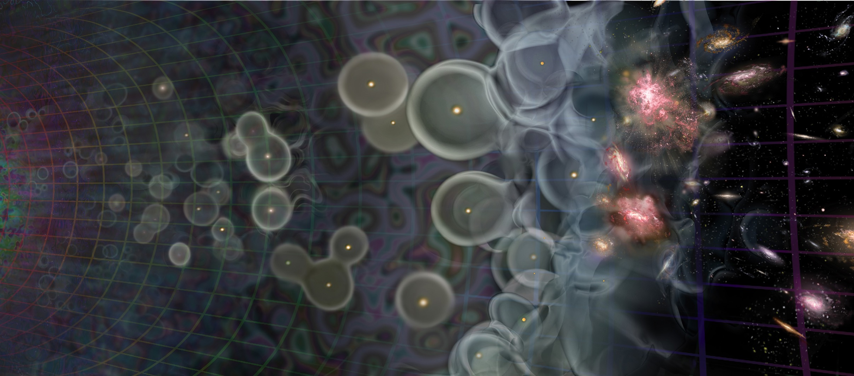
A.L.C.A.T.R.A.Z.
Parsons - UC Berkeley
Archival Lyman-Continuum and Theoretical Reionization Analysis vs Z
Isaac Meisenheimer
Rogier Windhorst

Slide 2







A.L.C.A.T.R.A.Z.
Collaborators
Rogier Windhorst, Rolf Jansen, Seth Cohen, Isaac Meisenheimer, Brent Smith, - Arizona State University, Mark Dijkstra - Institute of Theoretical Astrophysics, University of Oslo, Rich Bielby - University of Durham, Anton Koekemoer - Space Telescope Science Institute

Slide 3
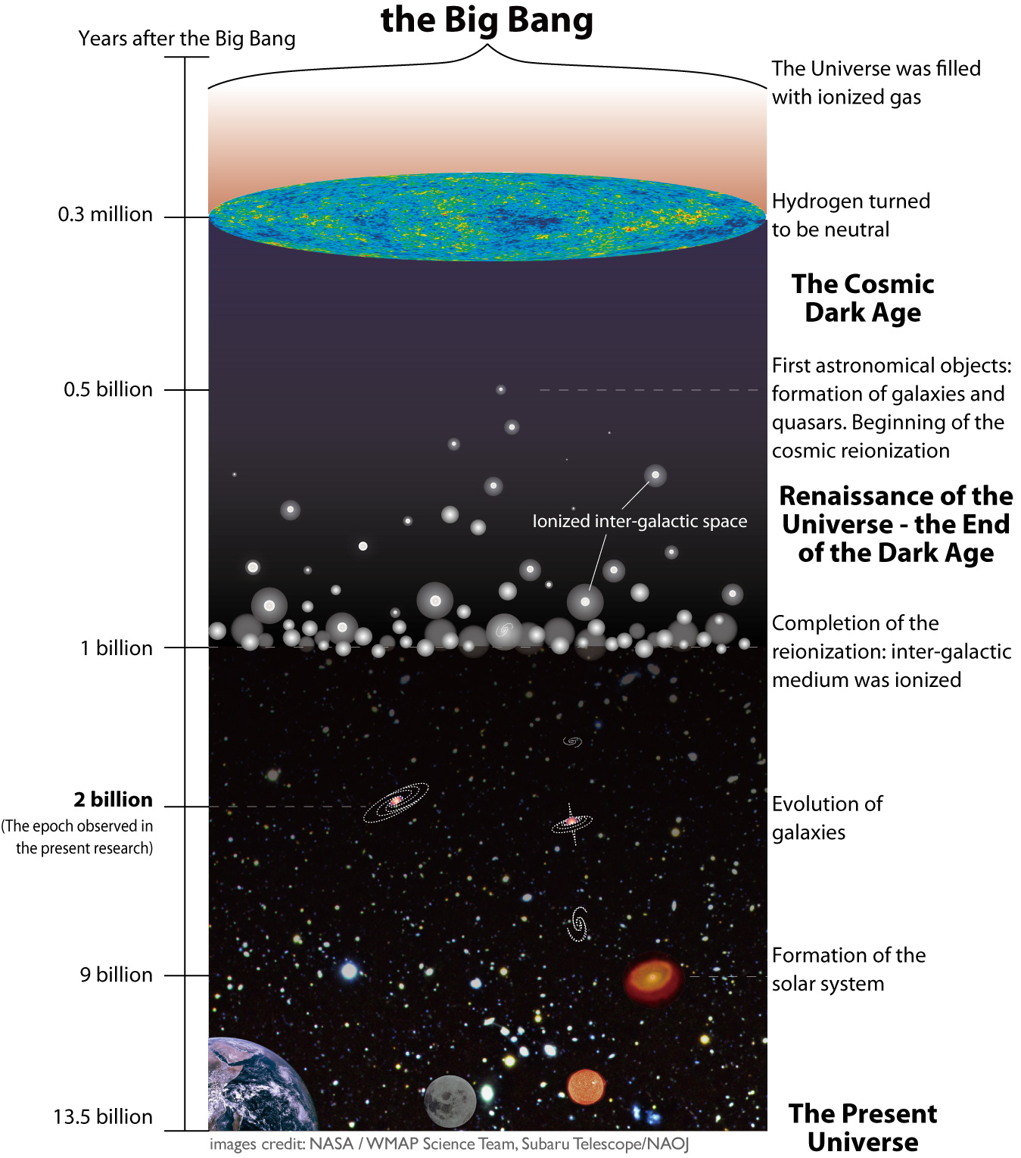

Slide 4
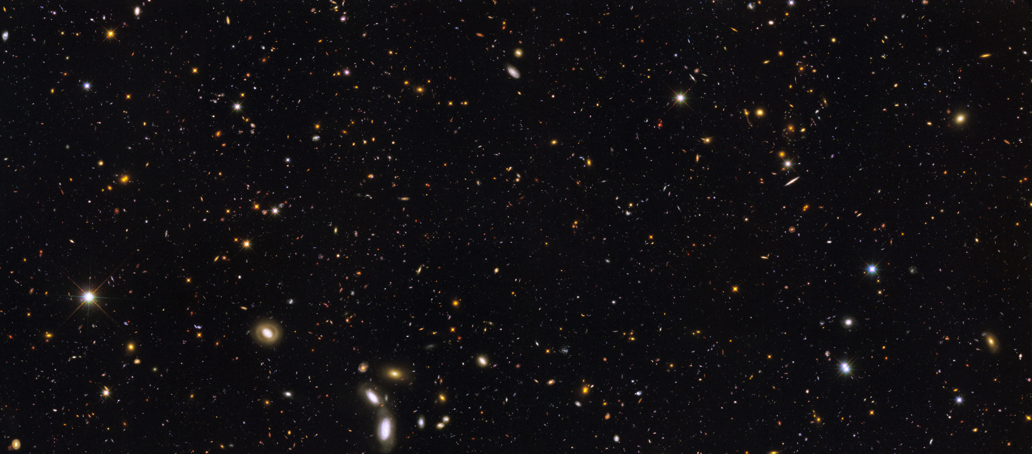
Great Observatories Origins Deep Survey (GOODS) - ERS

Slide 5
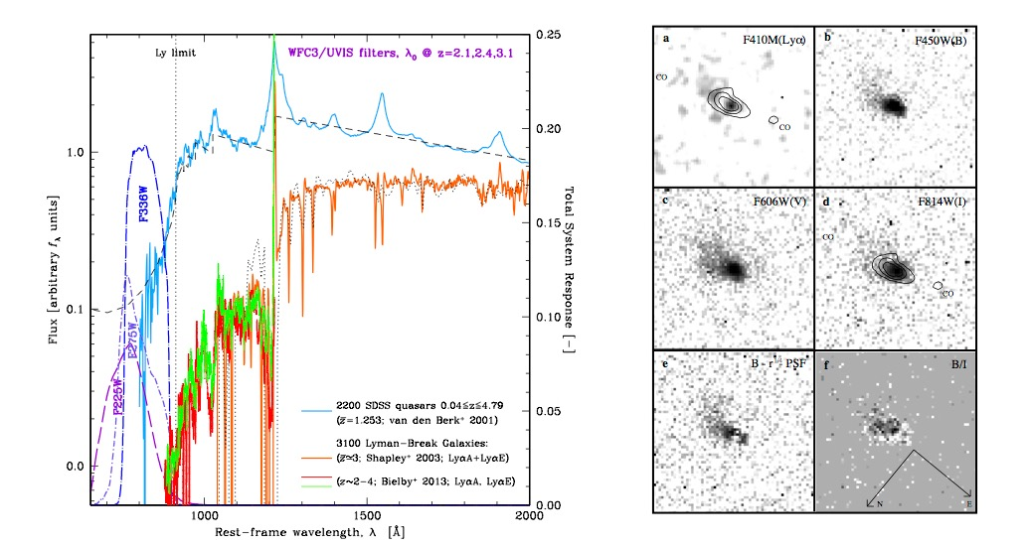
Fig. 1a [Right]: Composite rest-frame UV spectra from 2200 SDSS quasars (blue; van den Berk⁺ 2001) and 3100 LBGs [Shapley⁺ 2003 (orange); Bielby⁺2013 (red/green)]. WFC3 UV throughputs in F225W, F275W, F336W sample LyC for objects at z≃2.26, 2.45, 3.07. Fig. 1b [RIGHT]: Radio galaxy with weak AGN at z=2.390 (Windhorst⁺ 1998) in WFPC2 F410M (redshifted Lyα), B, V and I (longwards of Lyα). Bottom panels show the PSF-subtracted B-band image and (B–I) color gradient. In all panels, a blue cloud is visible towards the upper-left, along which LyC may escape. This is aligned with its radio source and CO- clouds.

Slide 6
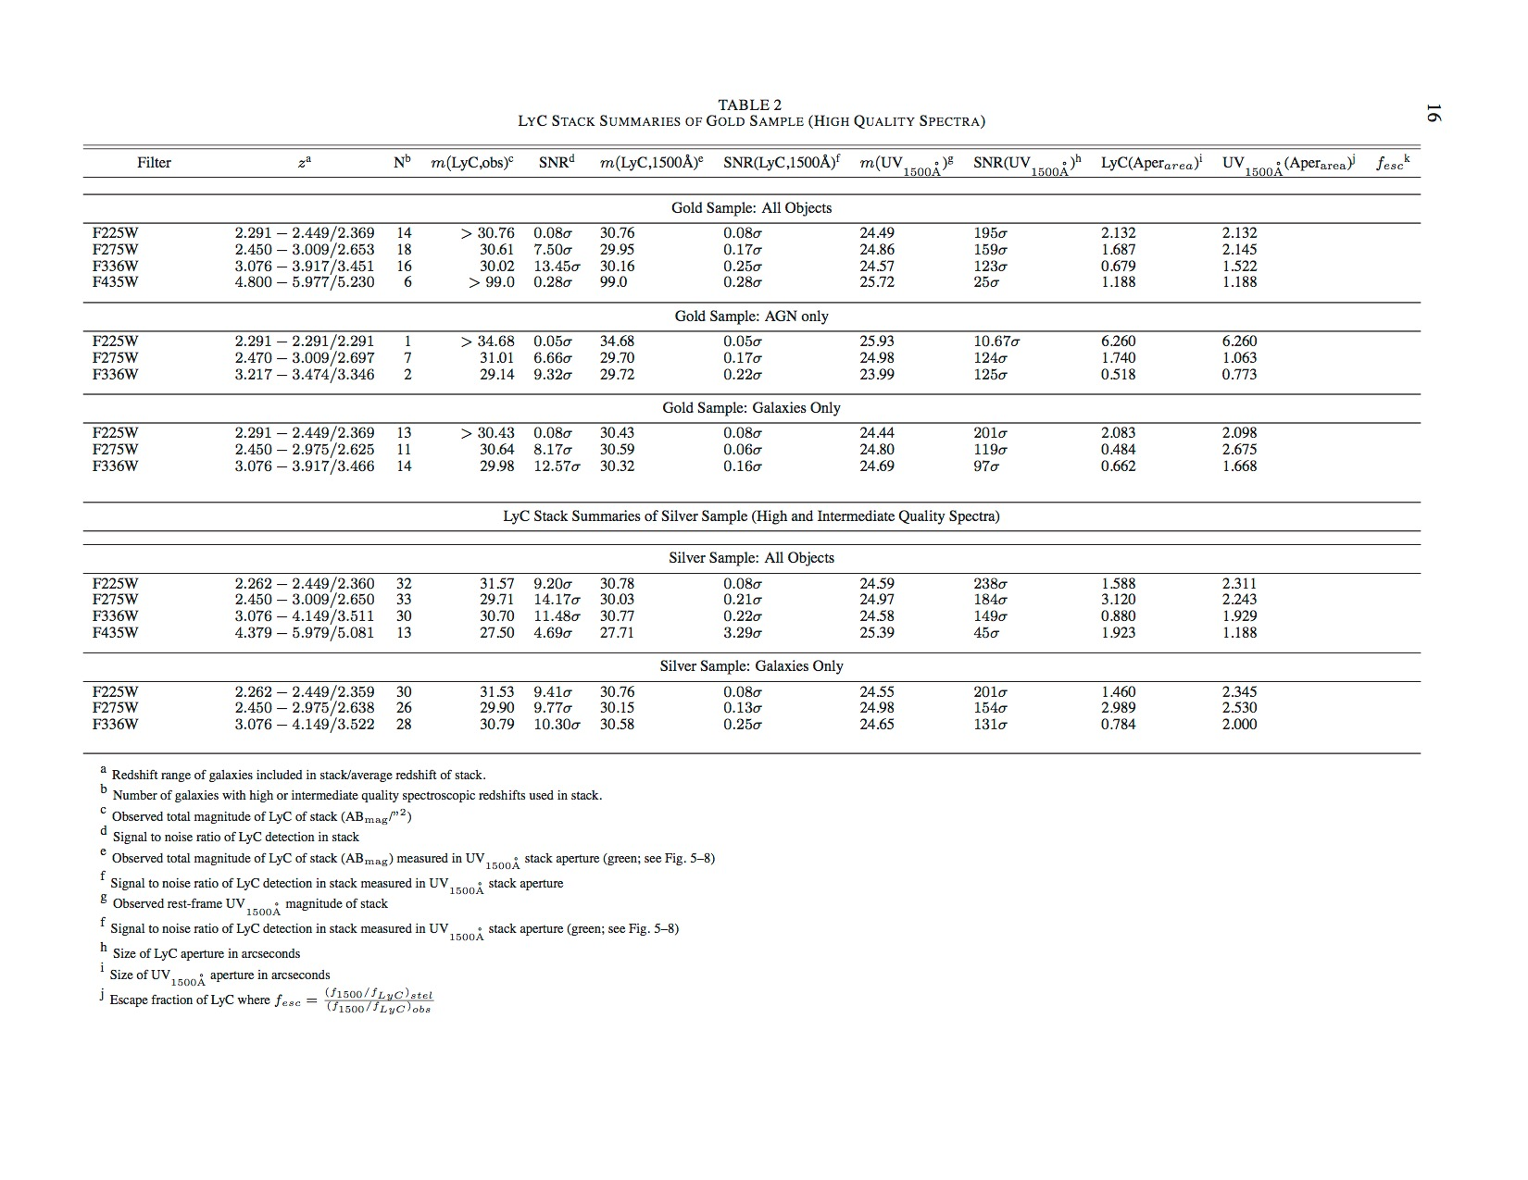
Gold vs Silver

Slide 7
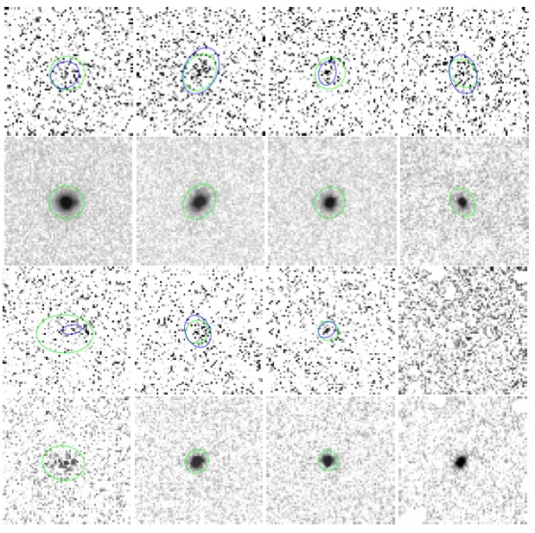
A.L.C.A.T.R.A.Z. - ERS V2.0
From Left to Right: Image stacks of Gold+Silver sample in the HST WFC3 filters F225W at z=2.26–2.47 (left), F275W at z=2.47–3.08 (middle left), F336W at z=3.08–4.35 (middle right), and ACS F435W filter at z=4.35–6 (right columns): (Row 1): LyC (Row 2): UVC for All Gold+Silver objects; (Row 3): LyC & (Row 4): UVC for (Gold) AGN. Blue ellipses indicate SExtractor LyC apertures using a 1σ detection criterion. Green ellipses are SExtractor MAG AUTO elliptical apertures, using the centroids and aperture of the restframe 1500A ̊ UV-continuum (UVC) stacks. All image-stacks are 6.′′4 × 6.′′4.
The remarkable result is that, despite very rigorous spectroscopic sample vetting, significant LyC is seen at most redshifts and for all samples.

Slide 8

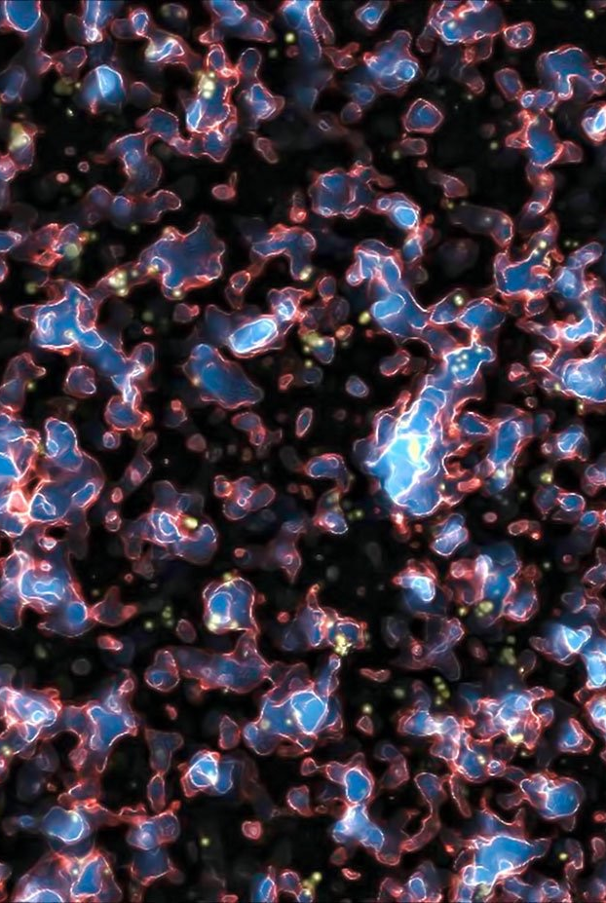
A.L.C.T.R.A.Z. 2015-16
Archival Lyman-Continuum and Theoretical Reionization Analysis vs Z
Proposal resubmitted for Hubble Cycle 23 and NSF funding, pending approval.
Further analysis of HUDF to check results from ERS
Study galaxy assembly with JWST
Study Super-Massive Black-Hole Growth with JWST
Study First Light and Reionization with JWST
Study best groups and clusters lenses to find z>10
M. Alvarez, R. Kaehler, and T. Abel.

Slide 9
Anderson, J., & Bedin 2010, PASP, 122, 1035, Arnouts, S., et al. 2005, ApJ, 619, L43, Atek, H., et al. 2014, A&A, 561, 89, Becker, R. H., et al. 2001, AJ, 122, 2850, Bielby, R., et al. 2013, MNRAS, 430, 425, Bouwens, R., et al. 2012, ApJ, 709, 133, Bouwens, R., et al. 2012, ApJ, 752, L5, Bridge, C., et al. 2010, ApJ, 720, 465
Bruzual, G. & Charlot, S. 2003, MNRAS, 344, 1000, Buat, V., et al. 2002, A&A 383, 801, Calzetti, D., et al. 1994, ApJ, 429, 582
Coe, D., et al. 2006, AJ, 132, 926, Cohen, S., et al. 2006, ApJ, 639, 731, Dahlen, T., et al. 2013, ApJ, 775, 93,
Dijkstra, M., & Kramer 2012, MNRAS, 424, 1672, Ellis, R. S., et al. 2012, ApJ, 763, 7 , Fan, X., et al. 2002, AJ, 123, 1247
Finkelstein, S., et al. 2011 arXiv:1110.3785, Freedman, D., & Diaconis, P. 1981, in “Probability Theory and Related Fields” (Berlin: Springer), Vol. 57, p. 453, Grazian, A., et al. 2011, A&A 532, A33, Haardt, & Madau, P. 1996, ApJ, 461, 20 Haardt, & Madau, P. 2012, ApJ, 746, 215 Hathi, N. P., et al. 2008, AJ, 135, 156
Hathi, N. P., et al. 2010, ApJ 720, 1708 Koekemoer, A. M., et al. 2013, ApJS, 209, 3 Madau, P. 1995 ApJ, 441, 18
Mesinger, A., & Haiman, Z. 2004, ApJ, 611, L69, Miller, et al. 2013 ApJS, 205, 13
Mostardi, R. E., Shapley, A. E., Nestor, D. B., Steidel, C. C., Reddy, N. , A., & Trainor, R. F. 2013, ApJ, 779, 65 ,Nestor, D., et al 2011, ApJ, 736, 18, Oesch, P., et al. 2012, ApJ, 759, 135 Planck Collab. XXV 2013arXiv1303.5076P, Prochaska, J, et al. 2009, ApJL, 705, 113, Rauch, M., et al. 2011, MNRAS, 418, 1115,
Schenker, M., et al. 2012, ApJ, 768, 196, Shapley, A., et al. 2003, ApJ, 588, 65, Siana, B., et al. 2009, ApJ, 698, 1273, Siana, B., et al. 2010, ApJ, 723, 241, Steidel, C, et al. 2010, ApJ, 717, 289,
Teplitz, H., et al. 2013, AJ, 146, 159, Vanden Berk, D. E., et al. 2001, AJ, 122, 549, Vanzella, E., et al. 2010, MNRAS, 404,1672 Vanzella, E., et al. 2012, ApJ, 751, 70, Voyer, E., et al. 2012, ApJ, 736, 80 Windhorst, R., et al. 1998, ApJL, 494, 27 Windhorst, et al. 2011, ApJS, 193, 27 (W11) Worseck, G, et al. astro-ph/1402.4154v1

